Slide 1
HOMOEOPROPHYLAXIS
PRESENTED BY :
DR.SONNY MON .R
ASSISTANT PROFESSOR
DEP.OF. ORGANON

Slide 4
Historical background
It started in 429 B.C by a Greek historian Thucydides later followed by Chinese in 900 A.D
In 1790 Edward Jenner, The Father of immunology who was the pioneer of small pox vaccine [world’s first vaccine]
The immunization was called vaccination because it was derived from virus affecting cows[ Latin: vacca – cow]
Later Louis Pasteur found out vaccine for rabies in 1880.

Slide 5
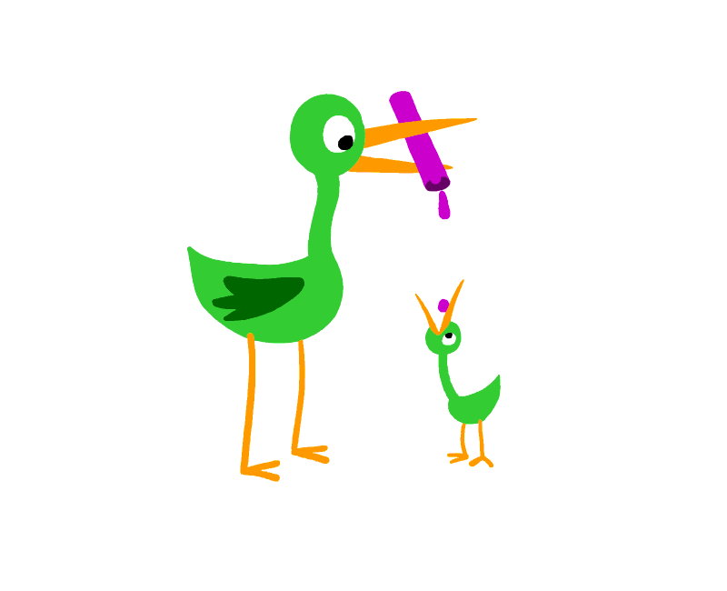
Prophylactic:
Guarding from or preventing the spread or occurrence of disease or infection
Tending to prevent

Slide 7
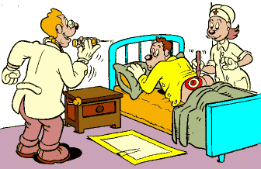
Vaccination:
It is method of giving antigens to stimulate the immune response through active immunization
A vaccine is an immune biological substance designed to produce specific protection against a given disease.

Slide 9
Routes of administration:
Deep subcutaneous or intramuscular route [ most vaccine]
Oral vaccine [ oral Bcg vaccine]
Intradermal [ Bcg vaccine]
Intranasal route [ live attenuated influenza vaccine]

Slide 12
Vaccination and Homoeoprophylaxis:
It has been noticed by homoeopaths that vaccination may lead to changes of personality, sleep patterns, bowel patterns and other alterations of natural cycles. each vaccine has acute symptom and latent symptoms
A vaccine, like any medicine, could cause a serious reaction. But the risk of vaccine causing serious harm or death is extremely small.
The true incidence of vaccine injury is 50 to 70 times higher than official statistics indicate

Slide 13
Vaccinosis:
Vaccinosis is an iatrogenic disease caused by an inoculation or immunization.
ILL EFFECTS OF VACCINATION = VACCINOSIS
J. Compton Burnett was the first to coin the term, vaccinosis.

Slide 14
VIEWS BY PIONEERS

Slide 15
JAMES TYLER KENT
He have investigated the pros and cons of vaccinations and after perennial observations and accurate weighting of circumstance came to the conclusion, hat the proofs that argue for vaccinations are very doubtful. In fact vaccinations have contributed enormously to damage individuals and the entire mankind.

Slide 16
Stuart close
Such a method is regarded as crude analogue or imitation of homoeopathic mechanical potentiation
This method is highly objectionable because it involves many uncertainties
There are no means of accurately registering and measuring all these activites

Slide 17
J.C. BURNETT
My own conception of the thing is just this: the vaccinated person is poisoned by the vaccine virus; what is called the “taking” is, in point of fact, the constitutional re action whereby the organism frees itself more or less from the inserted virus. If the person do not “take”, AND THE VIRUS HAS BEEN ABSORBED, the “ taking” becomes a chronic process – paresis, neuralgia, cephalalgiae, pimples, acne, and c. the less a person ”takes”’ therefore [ in such a case], the more is he likely to suffer from chronic vaccinosis, i.e., from the genuine vaccination disease in its chronic form, very frequently a neuralgia or paresis.

Slide 18
DR.SKINNER
Dr. Skinner have claimed that vaccination is a proof of the truth of homoeopathy
Homoeopathy is a system of curing – similia similibus curantur
Whereas vaccination is not a curative measure at all, but the preventive one.

Slide 19
PASTEUR’S EXPERIMENTS:
His experiments had shown him that an injection in the region of the skull of the virus of rabies always produced the malady in an acute form, but that an injection in the vein only occasionally had acute results, being often followed by chronic affection only, without baring or ferocity.
If dog were inoculated with fragments of marrow or nerve taken from a mad dog, the disease would be communicated.
Pasteur further stated that he had rendered twenty dogs proof against the disease by inoculating them with other virus than the virus of rabies. Fowls and pigeons injected with the latter became affected, but soon recovered spontaneously.

Slide 20
On the other hand it has been often noticed that a healthy person gets variola soon after vaccination, which to my mind militates in no wise against a belief in the protective power of vaccination, but is to be interpreted as meaning that the vaccinial infection was more than enough ; just the same as a little Aconite will lessen feverish- ness, while much Aconite will make the feverishness worse.

Slide 21
For in vaccinating a person we are diseasing him, we communicate vaccinosis to him: if he in addition to the vaccinosis, now get smallpox, he is more likely to die worse he has vaccinosis.

Slide 22
Now the world are rising against vaccination, I venture to foretell that in future the mortality in their unvaccinated off spring will be very small; probably only those who inherit the purulent diathesis; will die and many of these would be saved if homoeopathically handled or homoeoprophylactically vaccinated in refracted dose.

Slide 25
Dynamic or microscopic Homoeoprophylaxis:
The hahnemannian process is purely physical, objective and mechanical.
It does not involve any certain, unseen, unreliable nor unmeasurable factors
Its resulting product is stable and is under homoeopathic methods and principles and has proved it to be efficient
The process is practical illimitable.
Dynamic of homoeoprophylaxis according to law of similars is very effective in practice only in, the form of Dynamic dose, which is very essential.

Slide 26
Eg. of Dynamic Homoeoprophylaxis
Prevention of red rashes of Scarlatina during the epidemic with dynamic doses of Belladonna
Dynamic dose of Thuja Occidentalis – prophylactic against small pox in epidemics
Likewise, Pasteur, Jenner, were succeeded in their experiments by this way of dynamic dosage by attenuating the prepared vaccines (may accidently).
Thuja in Chronic neurotic Headaches

Slide 27
Hahnemann on Homoeoprophylaxis:
In 1799 – 3 years after the birth of homoeopathy in hahnemann’s landmark article ESSAY ON A NEW PRINCIPLE I RESOLVED IN THIS CASE OF SCARLET FEVER JUST IN THE ACT OF BREAKING OUT, not to act as usual in reference to individual symptoms, but if possible to obtain a remedy whose peculiar mode of action was calculated to produce in the healthy body most of the morbid symptoms which observed combined in this disease.

Slide 28
Hahnemann published this pamphlet Cure and prevention of scarlet fever in 1801. At the time he promoted Belladonna as a specific prophylactic remedy for scarlatina
In 1808 paper [observations on the scarlet fever” only the honest Sydenham perceived this, for he insists….. That no epidemic disease should be taken for any previous one treated in the same way, since all that break out at different times are different from each other.

Slide 29
Aphorism 4:
He I likewise, a preserver of health if he knows the things that derange health and cue and sustain disease, how to remove them from persons in health.

Slide 31
In his writings he spoke of it as a subdivision of sycosis.
In actually vaccinosis is neither psora nor sycosis, yet it can be similar to both. Vaccinosis is a man made fifth Miasm that has a separate classification.

Slide 32
Miasmatic approach:
Burnett to declare vaccinosis a variant of the sycosis Miasm.
As you will already Know, Sycosis is characterized by affections of the skin, the lymphatic's, the immune system, susceptibility to fungal infections, susceptibility to cold, damp weather, arthritis, affections of the blood, and many other symptoms of this sort.
Most importantly, it typical of the Sycotic Miasm and therefore of vaccinosis, to develop growths of all types – cysts, polyps, warts, tumours and cancers.

